Slide 1
Ethereum The Blockchain of Blockchains

Slide 2
Introduction
Why using Ethereum?
How to create your own coin
What is Blockchain?

Slide 3
Why using Ethereum?
World computer
General purpose
Programmable
Smart
At the end.. Ethereum is a blockchain

Slide 4
What is Blockchain? It’s a chain of blocks…
Distributed database of blocks
Transaction
Proof of work
Wallets

Slide 5
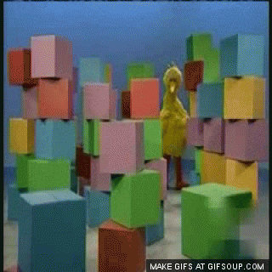
Blocks
Structure
Hash = digital signature
Previous hash
Timestamp
Data
Genesis block = first block

Slide 6
Transactions
Public key (address) of the sender
Public key (address) of the receiver
Value/amount of funds
Transaction ID
Signature
allow only the owner to spend their coins
Inputs
Outputs

Slide 7
Proof of work (mining)
Miners or validators?
Finding a block
nonce number
Consensus on difficulty
Block generation interval (10 minutes in Bitcoin)
Difficulty adjustment interval (in blocks)
Reward

Slide 8
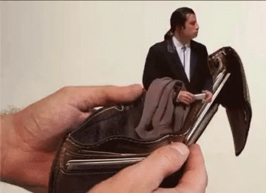
Wallets
Generating key pairs
Elliptic cryptography
Losing your private key = losing your wallet
Private key
Used for signing transactions
(so nobody could spend your coins)
Public key act as address
Used for receiving a payment

Slide 9
Polar Coin
Minimal blockchain
Gamification
Earn coin when time submitted

