Slide 1
Intro to Gradle
Zlatko Stamatov
JavaSkop
13 December 2015

Slide 2
What is gradle?
Yet another build tool?
On a scale from ant to maven, gradle would be in the middle

Slide 3
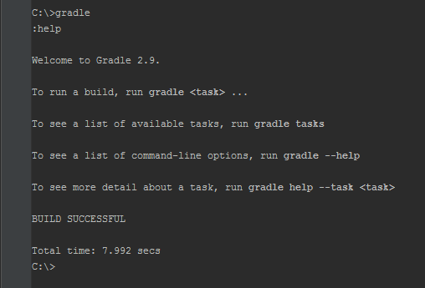
How can I use it?
Download gradle: http://gradle.org/gradle-download/
Unzip the downloaded file
Add its bin directory to PATH
Type “gradle”

Slide 4
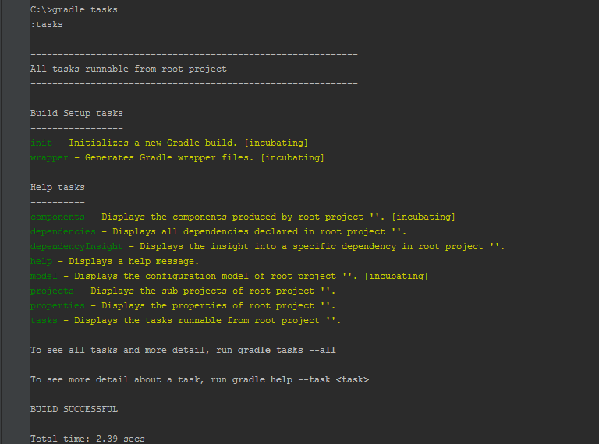
Gradle tasks
Type “gradle tasks”

Slide 5
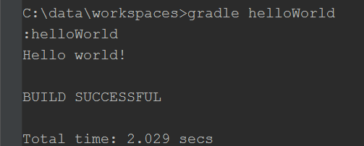
Hello world from Gradle
Create a build.gradle file
Type “gradle helloWorld”

Slide 6
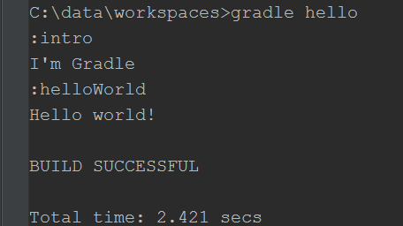
Task dependencies

Slide 7
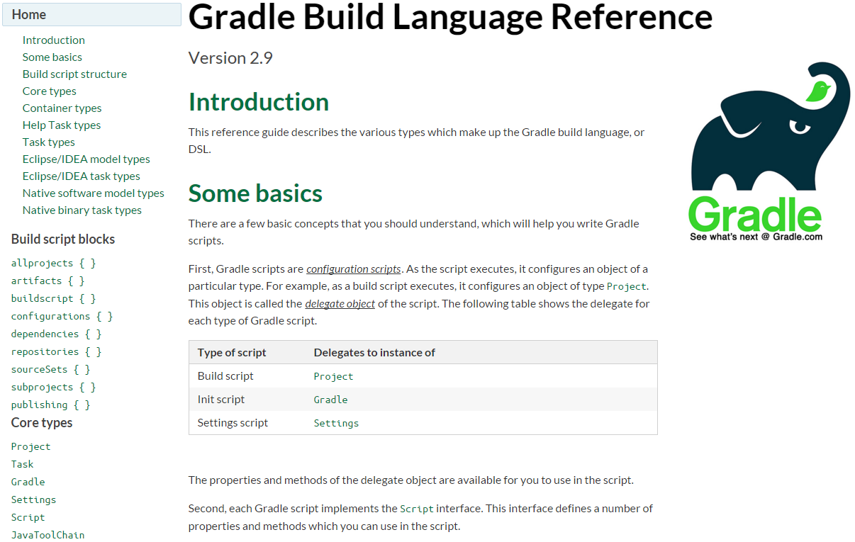
Gradle domain-specific language (DSL)
Groovy based
Well documented
https://docs.gradle.org/current/dsl/

Slide 8
Gradle Java plugin
Gradle comes with built in java plugin
The java plugin defines new tasks for building java projects
It can be used with only one extra line in the build.gradle file

Slide 9
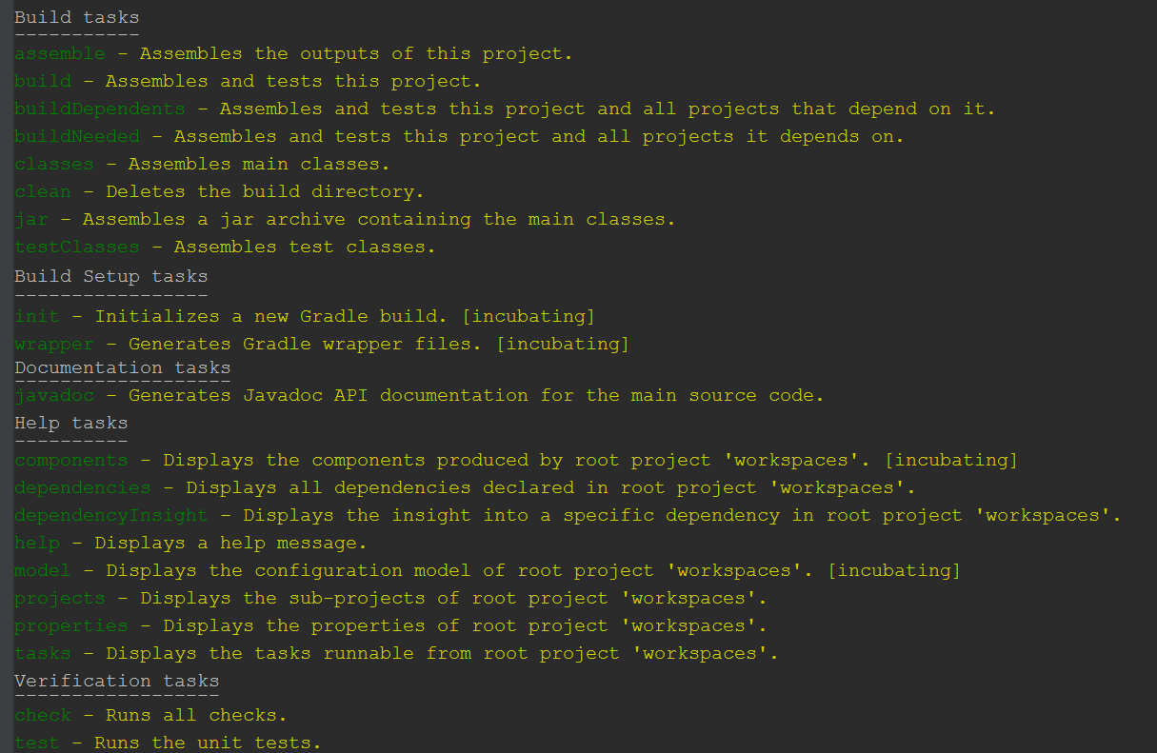

Slide 10
Building simple java application with gradle
https://github.com/Zlate87/java-gradle-example

Slide 11
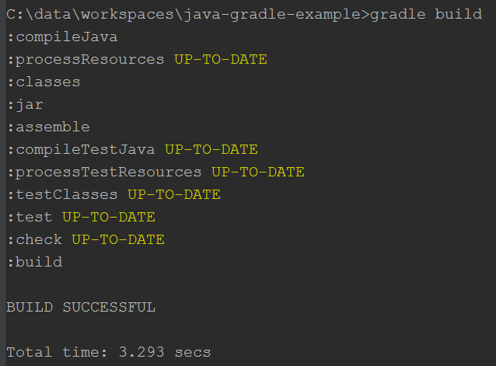
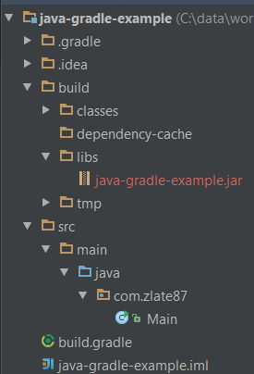

Slide 12
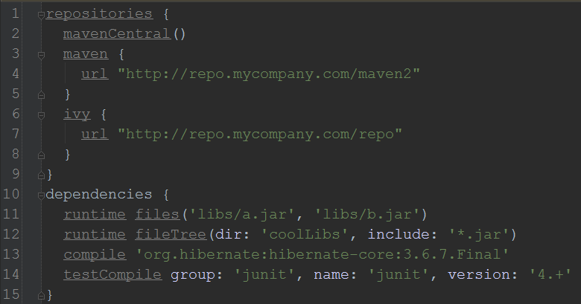
Dependencies

Slide 13
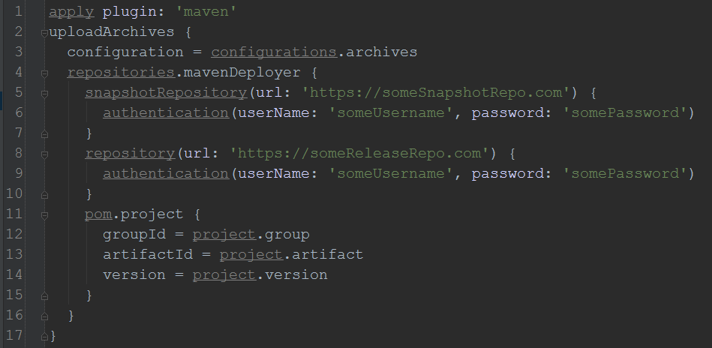
Gradle and Maven repo

Slide 14
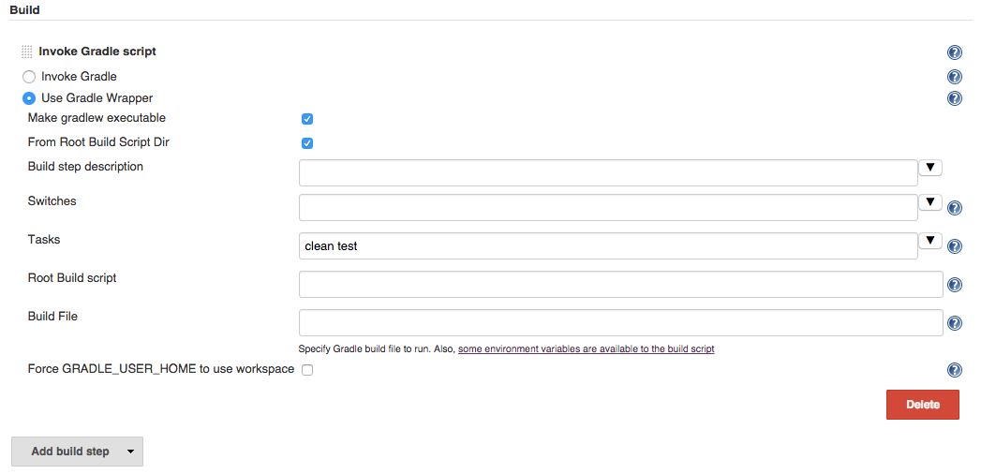
Gradle and jenkins
Jenkins gradle plugin is available
https://wiki.jenkins-ci.org/display/JENKINS/Gradle+Plugin

Slide 15
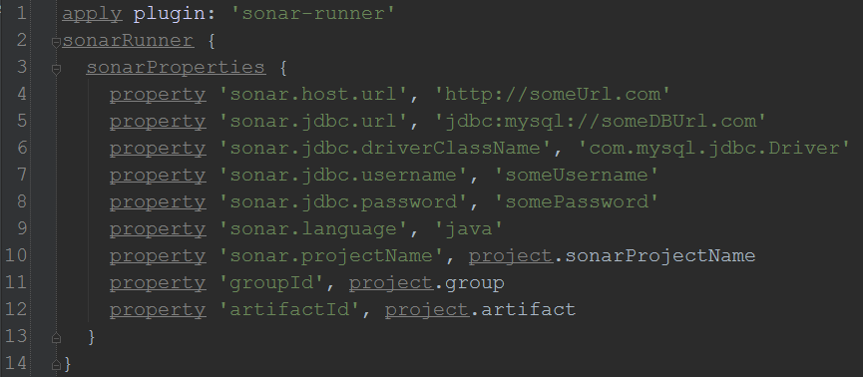
Gradle and sonar

Slide 16
Gradle release
Third party plugin: gradle-release [1]
Provides similar experience as maven release process
Simple to use
Well documented
Quite active on github
[1] https://github.com/researchgate/gradle-release

Slide 17
Maven archetype equivalent?
Sorry, but I have not found one
Few alternatives:
Build Init Plugin [1]
gradle-templates [2]
[1] https://docs.gradle.org/current/userguide/build_init_plugin.html
[2] https://github.com/townsfolk/gradle-templates

Slide 18
Android ♥ Gradle
Gradle is the default Android build tool
Google provides few Gradle plugins for Android

Slide 19
Gradle wrapper
Install gradle on your machine
Execute gradle task called wrapper
Commit the generated files for the wrapper
To use the wrapper just type gradlew instead of gradle
No need to manually install gradle on any other machine for this project

Slide 20
Creating Gradle plugin
Can be done in java or groovy
Define your own DSL extensions
JUnit test it
Build it and deploy it separately
Reuse It over and over

Slide 21
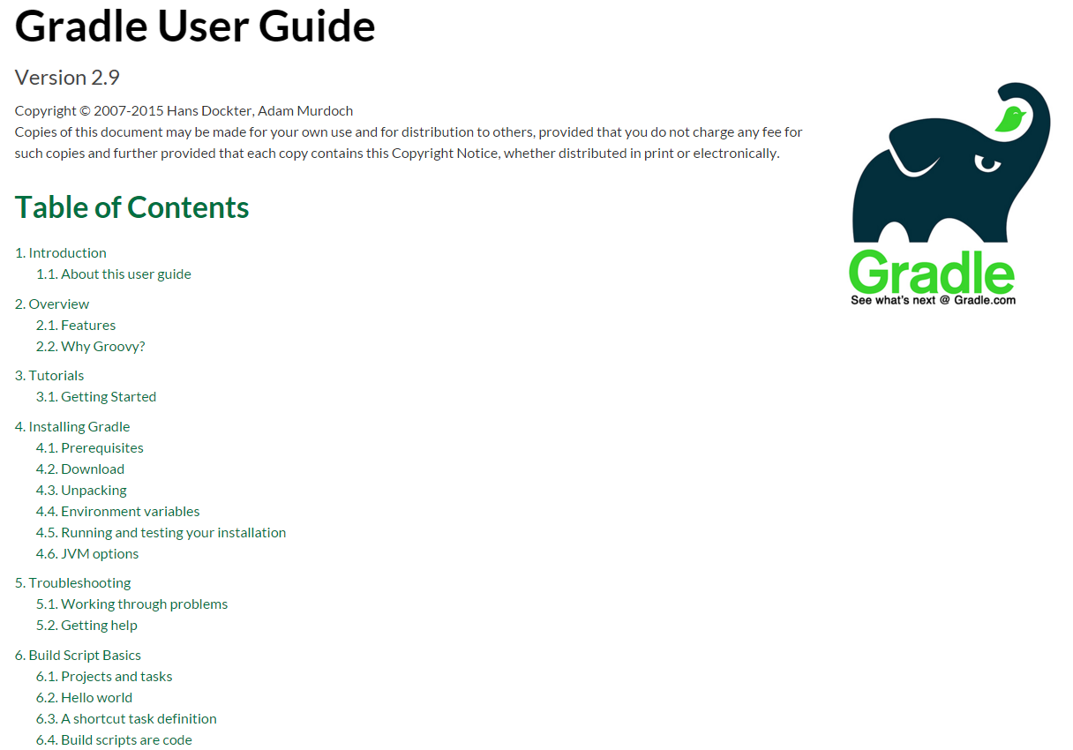
Gradle user guide
Contains 70 chapters
Extensive list of examples
https://docs.gradle.org/current/userguide/userguide.html

Slide 22
What to take from the presentation
Gradle is here to stay
It is easy to take it on a test drive
It can probably do whatever you did with Maven, and much much more
Is it for everyone? No!

Slide 23
?

